Slide 1
Limits of CFGs/PDAs
Nondeterministic PDAs are strictly more powerful than deterministic PDAs.
This is in contrast to the situation with finite automata
Some languages are not context-free. For example: a^{n}b^{n}c^{n}

Slide 2
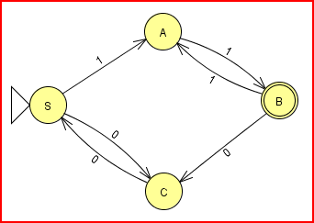
Regular Grammars
In a regular grammar, every production is of one of these forms:
A → bC
A → a
where A and C are non-terminals and a is a terminal
Any regular language that doesn’t include the empty string can be described with a regular grammar.
S → 0C
S → 1A
A → 1B
B → 0C
B → 1A
C → 0S
A → 1

Slide 3
Context-Sensitive Grammars
In a context-sensitive grammar, the LHS of a production can contain terminals (the context) in addition to a single non-terminal
Example: 0^{n}1^{n}2^{n}
S → 0 B S 2
S → 0 1 2
B 0 → 0 B
B 1 → 1 1
Derivation of 000111222
S
➔ 0 B S 2
➔ 0 B 0 B S 2 2
➔ 0 B 0 B 0 1 2 2 2
➔ 0 0 B B 0 1 2 2 2
➔ 0 0 B 0 B 1 2 2 2
➔ 0 0 0 B B 1 2 2 2
➔ 0 0 0 B 1 1 2 2 2
➔ 0 0 0 1 1 1 2 2 2

Slide 4
Chomsky Hierarchy
Unrestricted grammars (any symbols on both sides)
Equivalent in power to Turing Machines
Context-sensitive grammars
Context-free grammars
Regular grammars

Slide 5
Converting CFGs to PDAs
Key idea: PDA explores all possible derivations, keeping unmatched part of derivation on the stack
Grammar:
S → 1 S 0 S
S → 0 S 1 S
S → ε
Input:
0 1 1 1 0 0
Derivation (and stack contents):
S
➔ 0 S 1 S
➔ 0 S 1 S
➔ 0 1 S
➔ 0 1 S
➔ 0 1 1 S 0 S
➔ 0 1 1 S 0 S
➔ 0 1 1 1 S 0 S 0 S
➔ 0 1 1 1 S 0 S 0 S
➔ 0 1 1 1 0 S 0 S
➔ 0 1 1 1 0 S 0 S
➔ 0 1 1 1 0 0 S
➔ 0 1 1 1 0 0 S
➔ 0 1 1 1 0 0

Slide 6
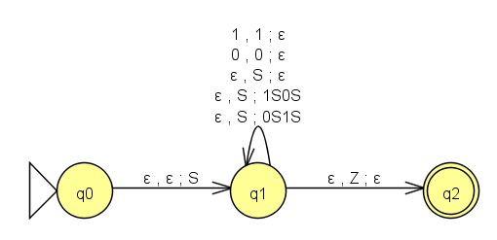
Converting CFGs to PDAs
Always 3 states
Center state has one transition per grammar rule plus one transition per alphabet symbol
S → 1 S 0 S
S → 0 S 1 S
S → ε

Slide 7
Pumping Lemma for CFLs
Let A be a context-free language. Then there is a constant integer k such that, for every string z in A of length at least k, you can split z as
uvwxy
where
vx is nonempty
|vwx| ≤ k
uv^{i}wx^{i}y is in A for all i ≥ 0

Slide 8
Proof Using Pumping Lemma
Prove that a^{n}b^{n}c^{n} is not a CFL
Assume that the language is a CFL
Let k be the constant of the Pumping Lemma, and choose the string z = a^{k}b^{k}c^{k}
Consider any legal split of z into uvwxyz
Since |vwx| has at most k characters, it is either all a’s and/or b’s or all b’s and/or c’s.
Now consider uv⁰wx⁰y = uwy
We’ve either removed some a’s and/or b’s or we’ve removed some b’s and/or c’s. Either way, we’ve created an imbalance
But a pumpable split must be possible if the language is a CFL. Our assumption is wrong and the language is not a CFL.

Slide 9
Proof Using Pumping Lemma
Prove that x#x is not a CFL, where x is a binary string
Assume that the language is a CFL
Let k be the constant of the Pumping Lemma, and choose the string z = 0^{k}1^{k}#0^{k}1^{k}
Consider any legal split of z into uvwxyz
vwx either occurs before the #, after the #, or it includes the #
If before or after, pumping will create an imbalance between the two sides.
If includes, pumping will either create extra #’s or will create an imbalance with the first 0^{k} and last 1^{k}.
But a pumpable split must be possible if the language is a CFL. Our assumption is wrong and the language is not a CFL.

